Slide 1
COMBINATIONAL LOGIC

Slide 2
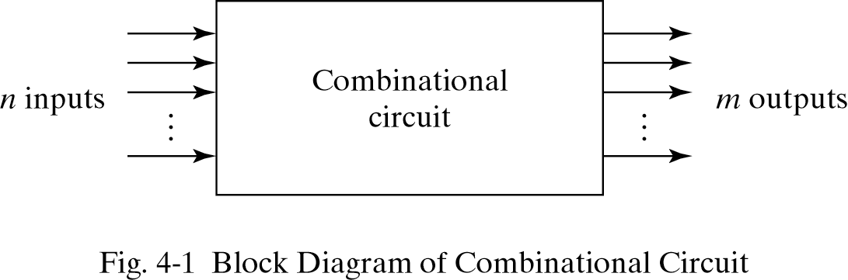

Slide 3
Half Adder
Combinational Circuit Which Performs Addition Of Two Binary Digits

Slide 4
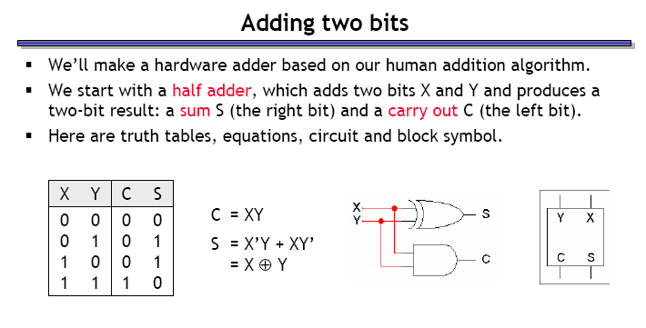
Truth Table for Half Adder
A | B | S | C
0 | 0 | 0 | 0
0 | 1 | 1 | 0
1 | 0 | 1 | 0
1 | 1 | 0 | 1
Equations for Half Adder
S(Sum)=AB’+A’B
S=A EXOR B
C(Carry)=A.B

Slide 5
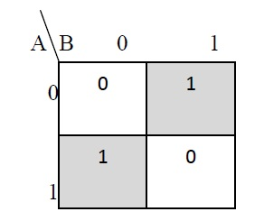
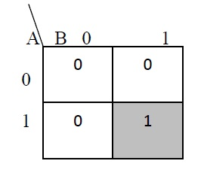
K Map for Sum
K Map for Carry
Equations for Half Adder
S(Sum)=AB’+A’B
S=A EXOR B
C(Carry)=A.B

Slide 6
Full Adder
Combinational Circuit Which Performs Addition Of Three Input Bits and gives Two Outputs

Slide 7
Truth Table for Full Adder
A | B | Cin | S | Cout
0 | 0 | 0 | 0 | 0
0 | 0 | 1 | 1 | 0
0 | 1 | 0 | 1 | 0
0 | 1 | 1 | 0 | 1
1 | 0 | 0 | 1 | 0
1 | 0 | 1 | 0 | 1
1 | 1 | 0 | 0 | 1
1 | 1 | 1 | 1 | 1
Equations for Full Adder
S(Sum)=A’B’Cin+AB’Cin’+A’BCin’+ABCin
S=A EXOR B EXOR Cin
C(Carry)=A.Cin+ A.B + B.Cin
Taking
x=A
y=B
z=Cin

Slide 8
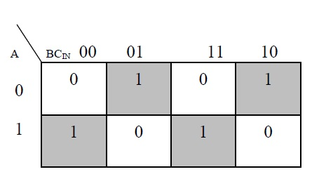
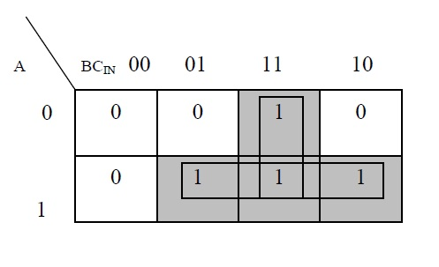
KMAP for SUM
KMAP for CARRY
Equations for Full Adder
S(Sum)=A’B’Cin+AB’Cin’+A’BCin’+ABCin
S=A EXOR B EXOR Cin
C(Carry)=A.Cin+ A.B + B.Cin
Taking
x=A
y=B
z=Cin

Slide 9
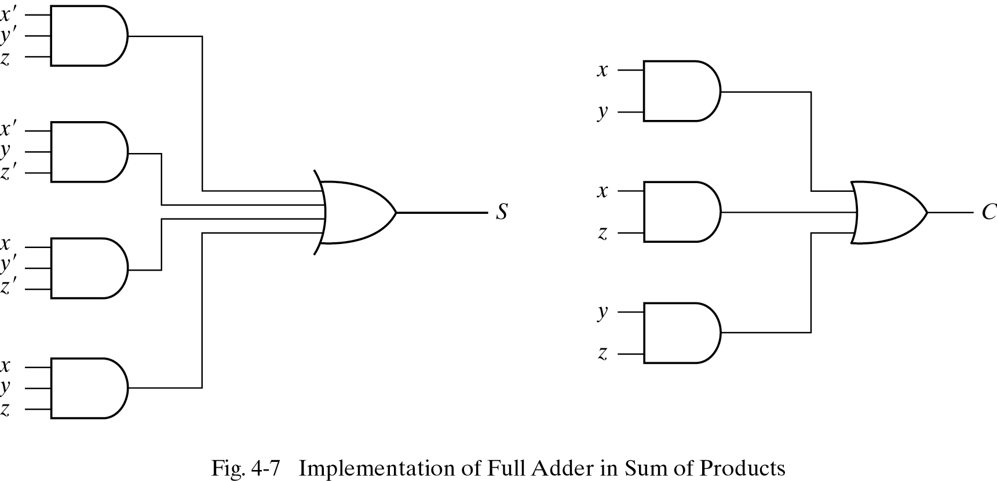
Implementation of Full Adder using AND-OR
Gate Network

Slide 10

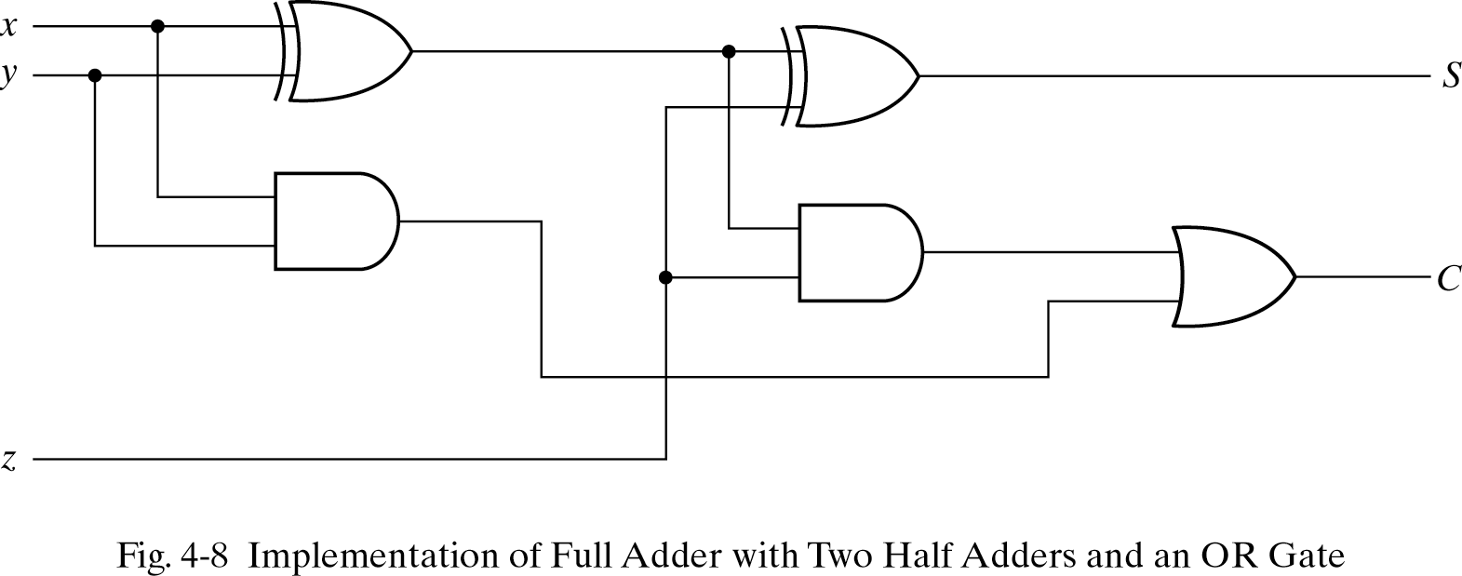
Implementation of Full Adder using
Two Half Adders …
C=XZ+XY+YZ
CONVERTING IT TO CANONICAL
FORM GIVES
C= XY’Z + X’YZ + XYZ’+XYZ
= XY’Z + X’YZ + XY(Z’+Z)
= XY’Z + X’YZ + XY
= Z(XY’ + X’Y) + XY
= Z (X Y) + XY
S=XY’Z’ +X’YZ’ + XYZ + X’Y’Z
= Z’ (XY’+X’Y) + Z (XY + X’Y’)
= Z’ (XY’ + X’Y) + Z (XY’ + X’Y)’
= Z (X Y)

Slide 11
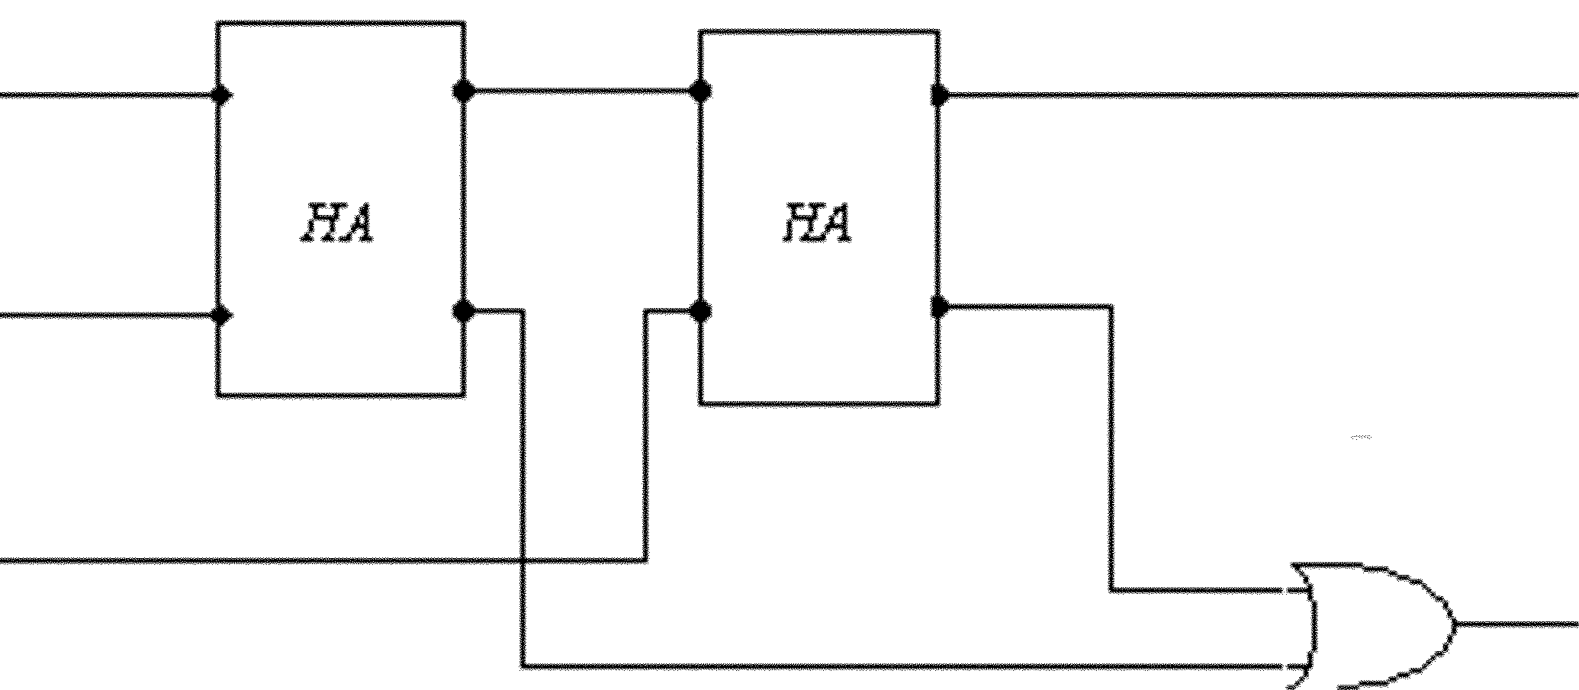
Implementation of Full Adder using Two Half Adders
X
S
Y
Z
C

Slide 12
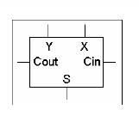
Full adder block diagram

Slide 13
Half Subtractor
Combinational Circuit that subtracts two bits and produces their difference and borrow

Slide 14
Truth Table for Half Subtractor
A | B | D | B
0 | 0 | 0 | 0
0 | 1 | 1 | 1
1 | 0 | 1 | 0
1 | 1 | 0 | 0

Slide 15
Truth Table for Half Subtractor
A | B | D | B
0 | 0 | 0 | 0
0 | 1 | 1 | 1
1 | 0 | 1 | 0
1 | 1 | 0 | 0
Equations for Half Subtractor
D(Difference)=AB’+A’B
D=A EXOR B
B(Borrow)=A’.B
A
D
B
B

Slide 16
Full Subtractor
Combinational Circuit Which Performs Subtraction involving Three Bits, i.e. A,B and Bin(Borrow from previous stage) and gives Two Outputs D(Diff) and B(Borrow)

Slide 17
Truth Table for Full Subtractor
A | B | Bin | D | Bout
0 | 0 | 0 | 0 | 0
0 | 0 | 1 | 1
0 | 1 | 0 | 1 | 0
0 | 1 | 1 | 0 | 1
1 | 0 | 0 | 1 | 0
1 | 0 | 1 | 0 | 1
1 | 1 | 0 | 0 | 1
1 | 1 | 1 | 1 | 1
Equations for Full Adder
S(Sum)=A’B’Cin+AB’Cin’+A’BCin’+ABCin
S=A EXOR B EXOR Cin
C(Carry)=A’.Cin+ A.B’ + B.Cin

Slide 18
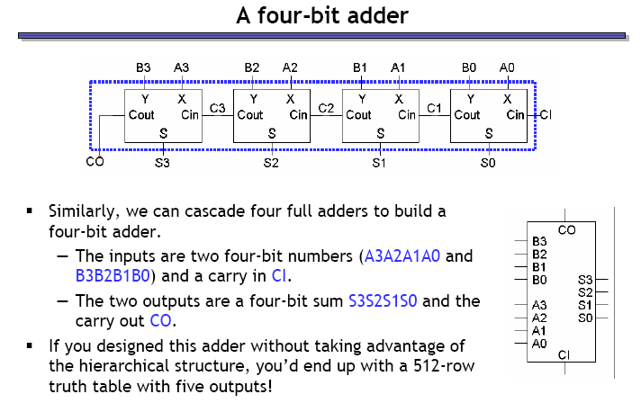
Four Bit Binary Adder

Slide 19
BCD ADDER
Adds two BCD digits using rules of Binary addition and produces a BCD digit.
A BCD digit cannot be greater than 9
If the sum <=9 and carry=0 then
Sum is correct, in true BCD form
If sum is invalid BCD i.e. >9 or carry =1 then
The Sum is wrong and needs correction.
Correction by adding 6 (0110) to the sum

Slide 20
S₃ | S₂ | S₁ | S₀ | Y
0 | 0 | 0 | 0 | 0
0 | 0 | 0 | 1 | 0
0 | 0 | 1 | 0 | 0
0 | 0 | 1 | 1 | 0
0 | 1 | 0 | 0 | 0
0 | 1 | 0 | 1 | 0
0 | 1 | 1 | 0 | 0
0 | 1 | 1 | 1 | 0
1 | 0 | 0 | 0 | 0
1 | 0 | 0 | 1 | 0
1 | 0 | 1 | 0 | 1
1 | 0 | 1 | 1 | 1
1 | 1 | 0 | 0 | 1
1 | 1 | 0 | 1 | 1
1 | 1 | 1 | 0 | 1
1 | 1 | 1 | 1 | 1
Truthtable FOR SUM>9
Kmap gives:
Y=S₃ S₂ +S₃S₁

Slide 21
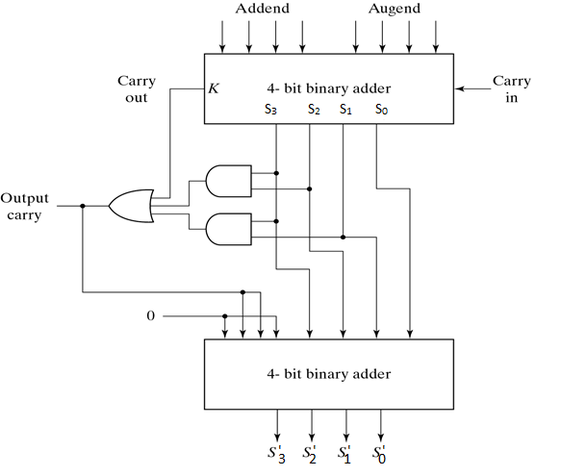
BCD adder
Numbers that need
correction (add 6) are:
01010 (10)
01011 (11)
01100 (12)
01101 (13)
01110 (14)
01111 (15)
10000 (16)
10001 (17)
10010 (18)
10011 (19)
Decides to add 6?
Adds 6

Slide 22
BCD adder
Numbers that need correction (add 6) are:
K S₃ S₂ S₁S₀
0 1 0 1 0 (10)
0 1 0 1 1 (11)
0 1 1 0 0 (12)
0 1 1 0 1 (13)
0 1 1 1 0 (14)
0 1 1 1 1 (15)
1 0 0 0 0 (16)
1 0 0 0 1 (17)
1 0 0 1 0 (18)
1 0 0 1 1 (19)
C = K + S₃ S₂ +S₃S₁

Slide 23
Magnitude Comparator
It is a combinational circuit that compares to numbers and determines their relative magnitude
The output of comparator is usually 3 binary variables indicating: A>B
A=B
A<B
For example to design a comparator for 2 bit binary numbers A (A1A0) and B (B1B0) we do the following steps:

Slide 24
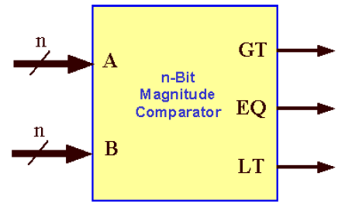
N Bit Magnitude Comparator

Slide 25
1 Bit Comparator Truth table
A | B | A>B | A<B | A=B
0 | 0 | 0 | 0 | 1
0 | 1 | 0 | 1 | 0
1 | 0 | 1 | 0 | 0
1 | 1 | 0 | 0 | 1

Slide 26
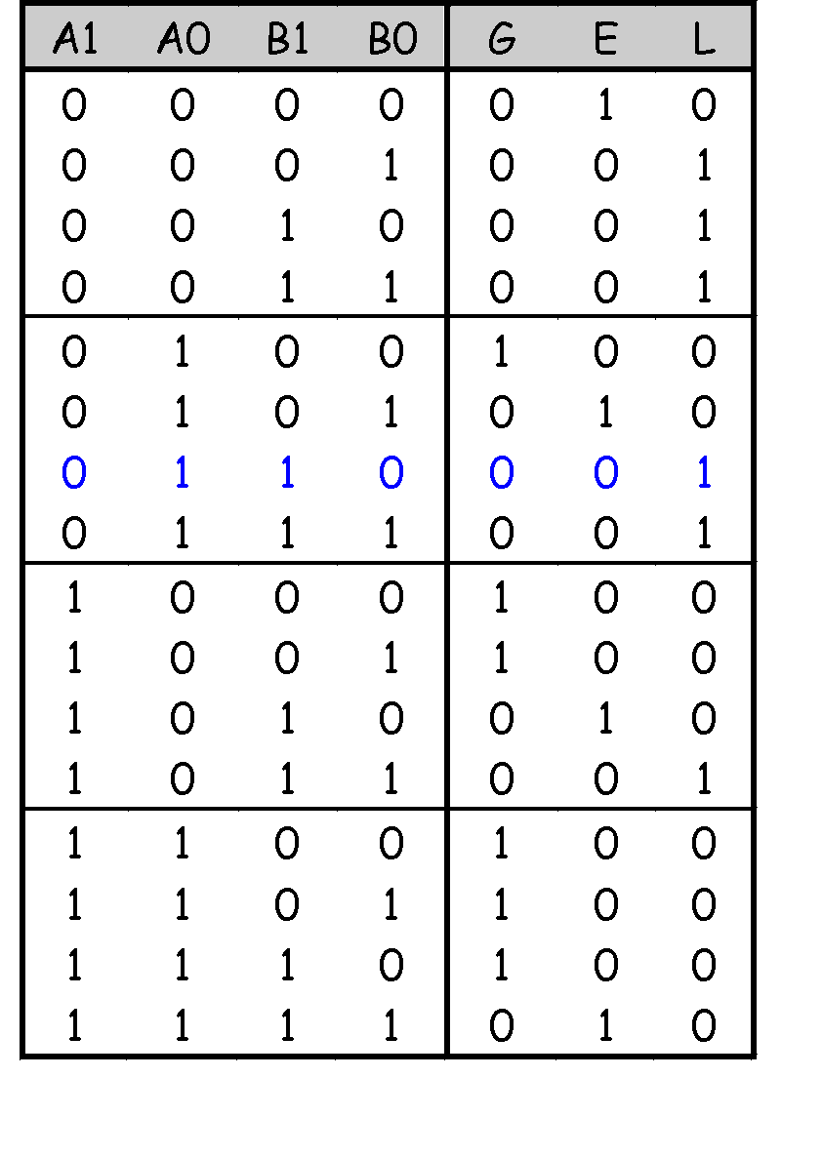
Truth table for 2-bit Magnitude Comparator
G for A>B
E for A+B
L for A<B

Slide 27

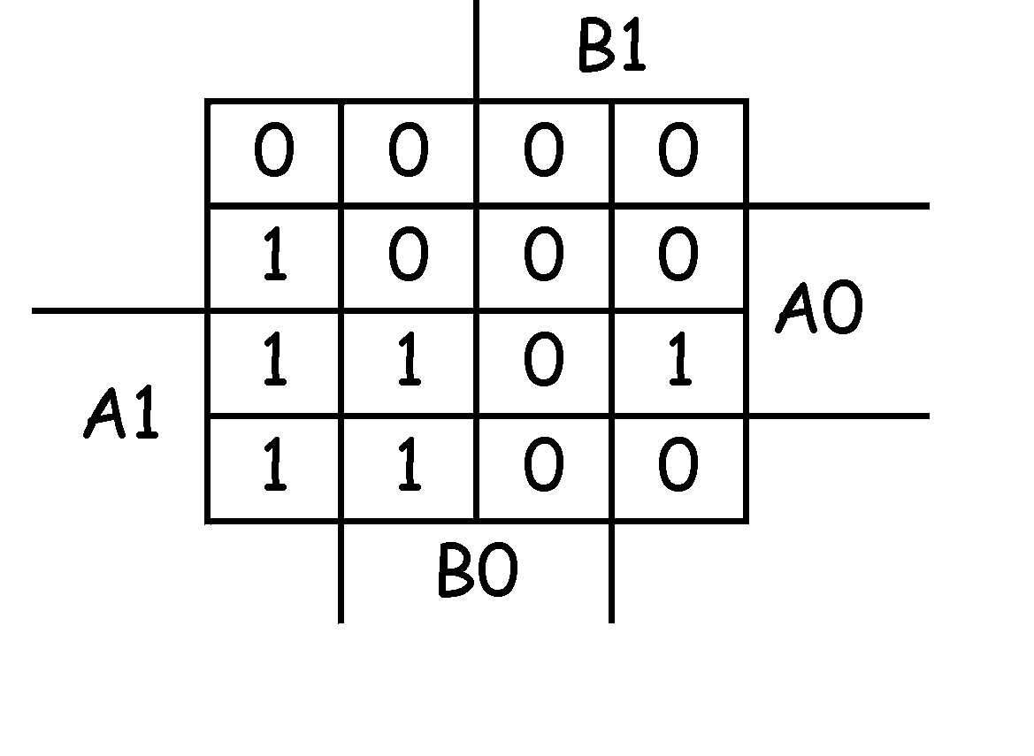
K Map for 2 Bit comparator
Let’s use K-maps. There are three functions (each with the same inputs
(A1 A0 B1 B0), so we need three K-maps
G(A1,A0,B1,B0) = A1 A0 B0’ + A0 B1’ B0’ + A1 B1’

Slide 28
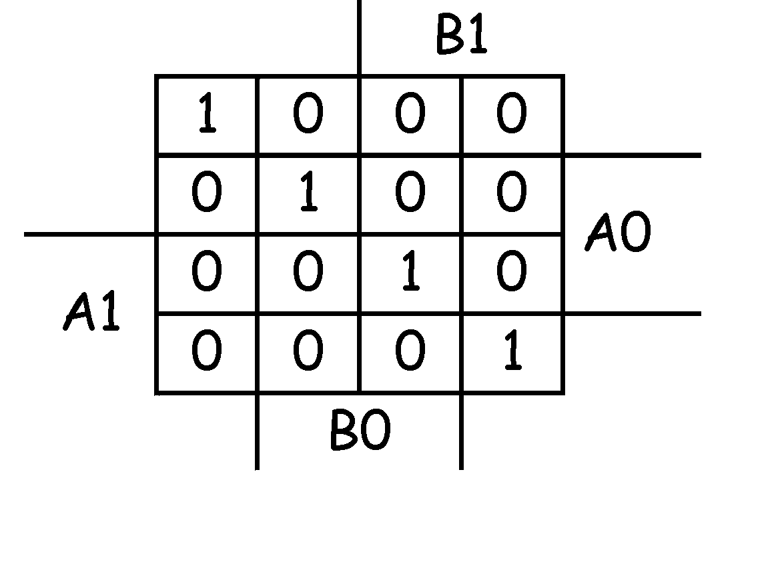
K Map for 2 Bit comparator
E(A1,A0,B1,B0) = A1’ A0’ B1’ B0’ + A1’ A0 B1’ B0 + A1 A0 B1 B0 + A1 A0’ B1 B0’
= (A0 EXNOR B0) (A1 EXNOR B1)

Slide 29
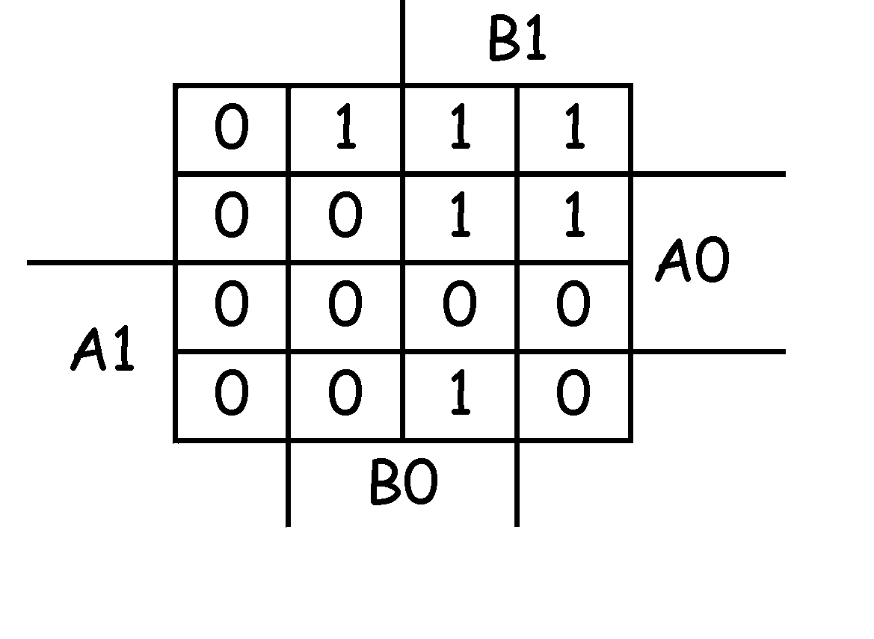
K Map for 2 Bit comparator
L(A1,A0,B1,B0) = A1’ A0’ B0 + A0’ B1 B0 + A1’ B1

Slide 30
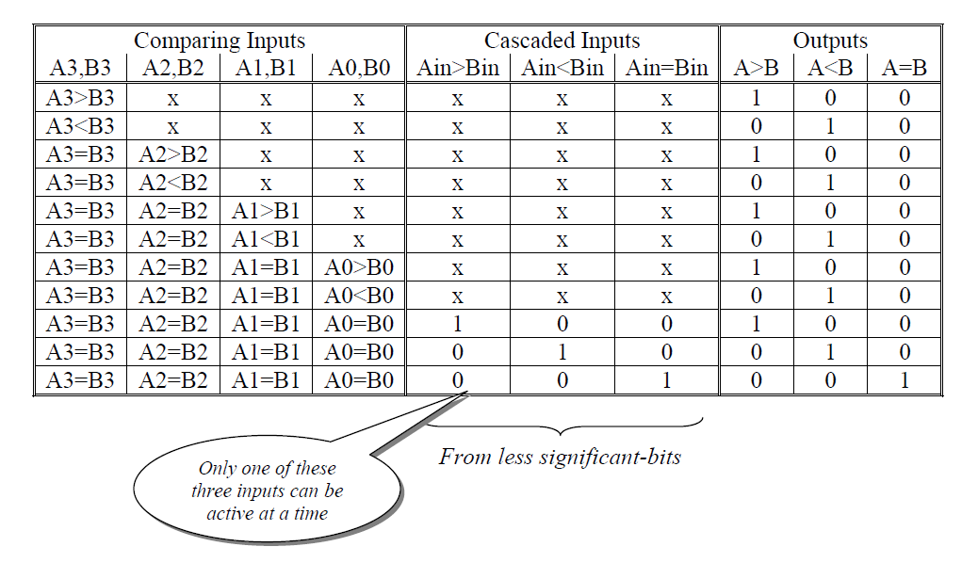
4 Bit Magnitude Comparator

Slide 31
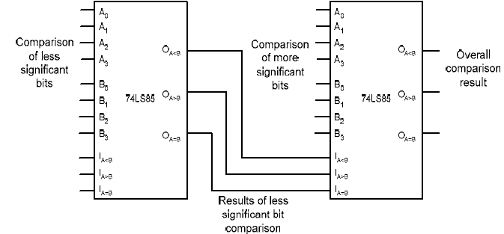
Cascadable 4-Bit Magnitude Comparator
One thing to notice is how the IC 74LS85 uses the cascaded inputs.
They can only affect the output if the current set of 4 bits are equal. This design forces us to compare the lower bits first and pass the outputs of the lower order comparison to the next comparator.

Slide 32
MULTIPLEXERS AND DEMULTIPLEXERS

Slide 33
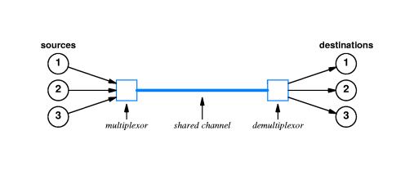
Mutiplexing
Multiplexing allows one to select one of the many possible sources.

Slide 34
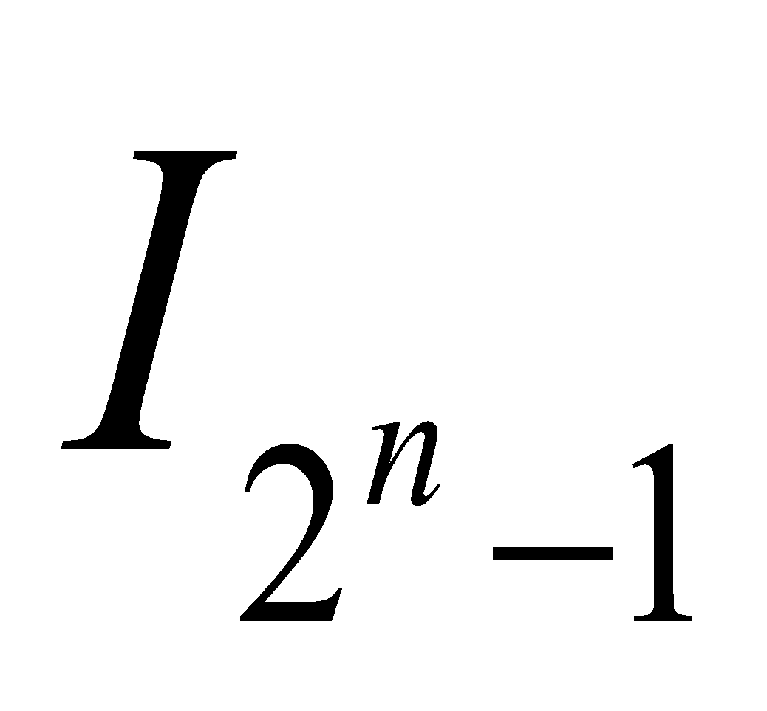
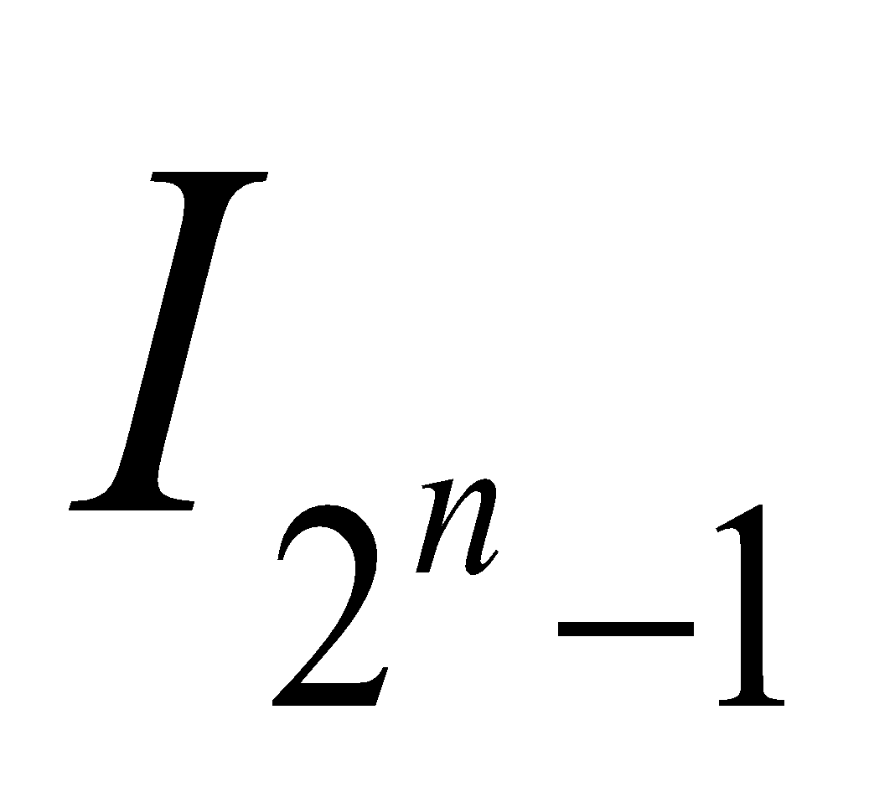
I₀
I₁
Z
2^{n} : 1
S_{n-1}
S₁
S₀
In general for a 2^{n}:1 MUX with control signals/inputs
S_{n-1} ··· S₁S₀ & “data” inputs I₀, ···, ,
Z = I_{i} when S_{n-1} ··· S₁S₀ combination represents #i in binary.

Slide 35
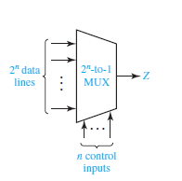
Multiplexers

Slide 36
2:1 Multiplexer
Number of inputs=2
Number of outputs=1
Number of selection lines=1
I₀
2:1
MUX
Z
I₁
S₀

Slide 37
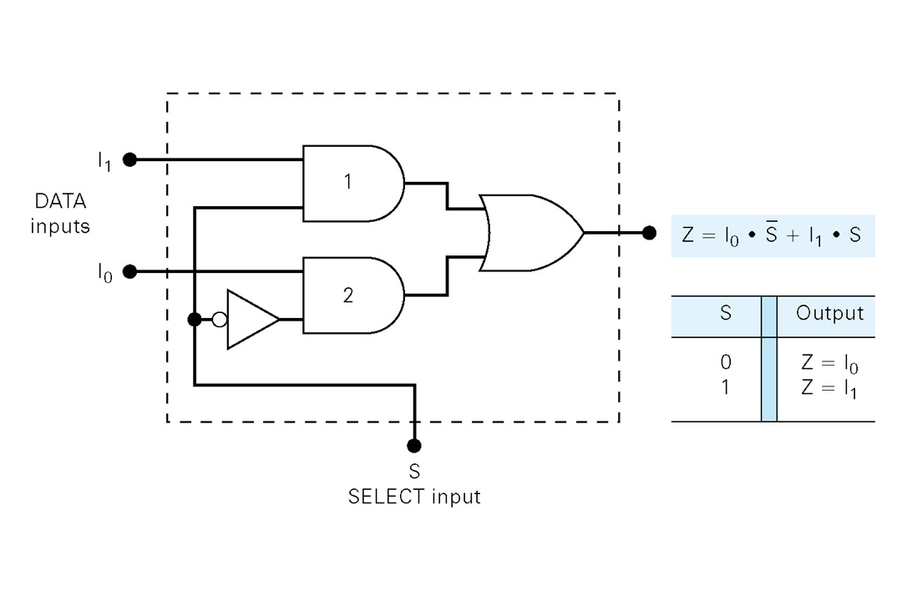
2:1 Multiplexer

Slide 38
4:1 Multiplexer
Number of inputs=4
Number of outputs=1
Number of selection lines=2
I₀
Z
I₁
4:1
MUX
I₂
I₃
S₁
S₀

Slide 39
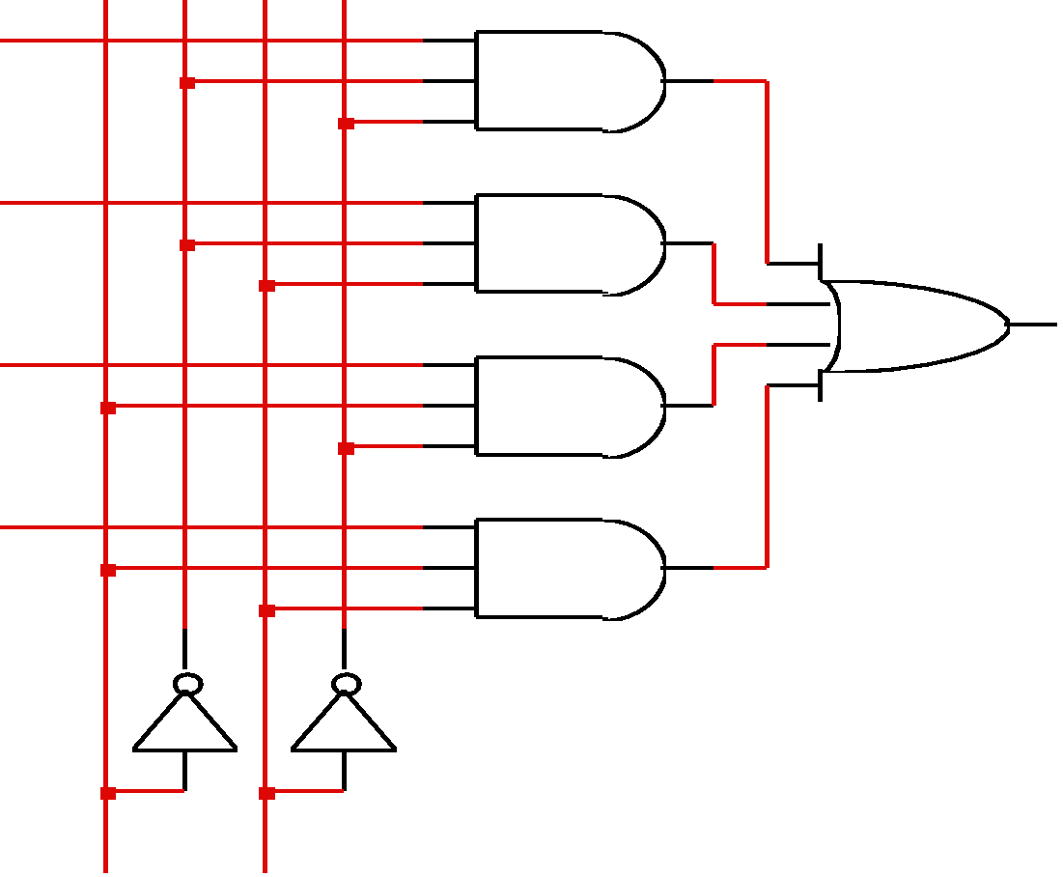
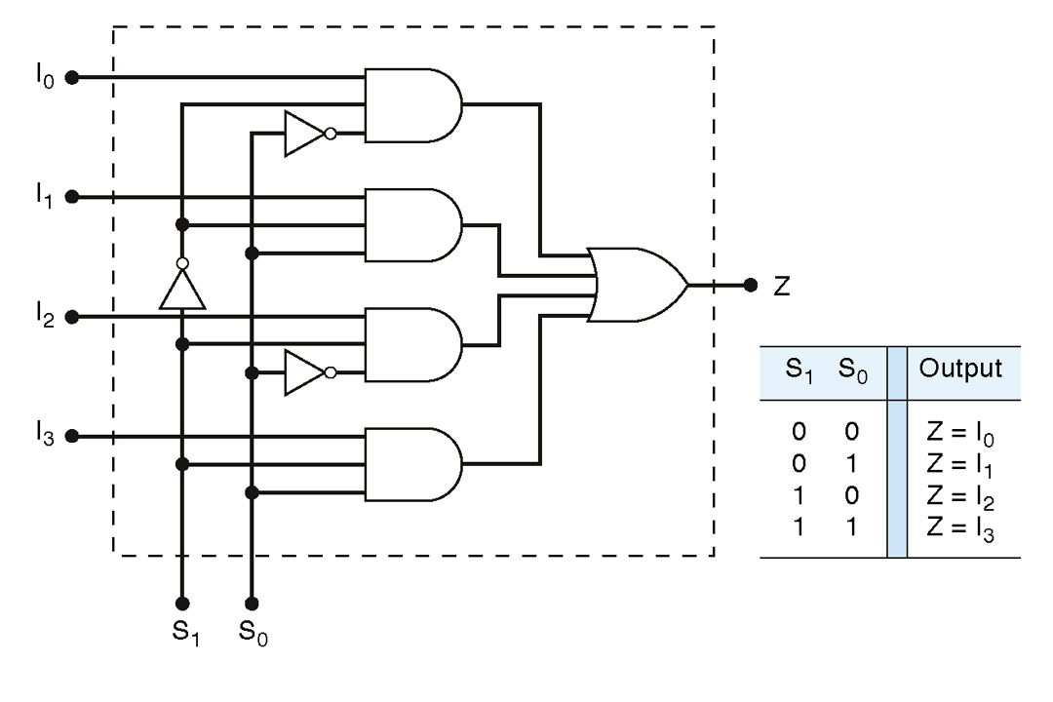
4:1 Multiplexer
I₀
I₁
I₂
I₃
S₁
S₀
Z=S₀’S₁’IO+S₀S₁’I1+S₀’S₁I2+S₀S₁I3

Slide 40





8:1 Multiplexer
Number of inputs=8
Number of outputs=1
Number of selection lines=3
I
0
I
1
I
2
I
3
8:1
I
mux
4
I
5
I
6
I
7
S₂
S₁
S₀

Slide 41
8:1 Multiplexer
S2 | S1 | S0 | ENABLE E | OUTPUT Y
X | X | X | 0 | 0
0 | 0 | 0 | 1 | I₀
0 | 0 | 1 | 1 | I₁
0 | 1 | 0 | 1 | I₂
0 | 1 | 1 | 1 | I₃
1 | 0 | 0 | 1 | I₄
1 | 0 | 1 | 1 | I₅
1 | 1 | 0 | 1 | I₆
1 | 1 | 1 | 1 | I₇
Y=S₂’S₁’S₀’I₀+S₂’S₁’S₀I₁+S₂’S₁S₀’I₂+S₂’S₁S₀I₃ +S₂S₁’S₀’I₄+S₂S₁’S₀ I₅+S₂S₁S₀’ I₆+S₂S₁S₀ I₇

Slide 42
DEMULTIPLEXER
Z
1: 2^{n} Demux
x
One Input Line
S_{n-1}
S₁
S₀

Slide 43
1:4 Demultiplexer
Input Line | S1 | S0 | Y₀ | Y₁ | Y₂ | Y₃
I | 0 | 0 | I | 0 | 0 | 0
I | 0 | 1 | 0 | I | 0 | 0
I | 1 | 0 | 0 | 0 | I | 0
I | 1 | 1 | 0 | 0 | 0 | I
Y=S₂’S₁’S₀’I₀+S₂’S₁’S₀I₁+S₂’S₁S₀’I₂+S₂’S₁S₀I₃ +S₂S₁’S₀’I₄+S₂S₁’S₀ I₅+S₂S₁S₀’ I₆+S₂S₁S₀ I₇

Slide 44
1:8 Demultiplexer
Input Line | S2 | S1 | S0 | Y₀ | Y₁ | Y₂ | Y₃ | Y₄ | Y₅ | Y₆ | Y₇
I | 0 | 0 | 0 | I | 0 | 0 | 0 | 0 | 0 | 0 | 0
I | 0 | 0 | 1 | 0 | I | 0 | 0 | 0 | 0 | 0 | 0
I | 0 | 1 | 0 | 0 | 0 | I | 0 | 0 | 0 | 0 | 0
I | 0 | 1 | 1 | 0 | 0 | 0 | I | 0 | 0 | 0 | 0
I | 1 | 0 | 0 | 0 | 0 | 0 | 0 | I | 0 | 0 | 0
I | 1 | 0 | 1 | 0 | 0 | 0 | 0 | 0 | I | 0 | 0
I | 1 | 1 | 0 | 0 | 0 | 0 | 0 | 0 | 0 | I | 0
I | 1 | 1 | 1 | 0 | 0 | 0 | 0 | 0 | 0 | 0 | I
Y=S₂’S₁’S₀’I₀+S₂’S₁’S₀I₁+S₂’S₁S₀’I₂+S₂’S₁S₀I₃ +S₂S₁’S₀’I₄+S₂S₁’S₀ I₅+S₂S₁S₀’ I₆+S₂S₁S₀ I₇

Slide 45
Decoders
A decoder has
N inputs
2^{N} outputs
A decoder selects one of 2^{N} outputs by decoding the binary value on the N inputs.
Exactly one output will be active for each combination of the inputs.

Slide 46
Decoders
A decoder has
N inputs
2^{N} outputs
Size of the Decoder-
“n X m lines”
“n to m lines”

Slide 47
Decoders
A decoder is a multiple-input, multiple-output combinational logic circuit that converts coded inputs into coded outputs, where the input and output codes are different.
N input lines
n:2^{n}
decoder
M Output Lines
Where m=2^{n}
Enable

Slide 48
2 to 4 Binary Decoder
Truth table for a 2-to-4 binary decoder
Inputs | Outputs
EN I1 I0 | Y3 Y2 Y1 Y0
0 X X 1 0 0 1 0 1 1 1 0 1 1 1 | 0 0 0 0 0 0 0 1 0 0 1 0 0 1 0 0 1 0 0 0
2-to-4
Decoder
I0 Y0
I1 Y1
Y2
EN Y3
”don’t-care” notation

Slide 49

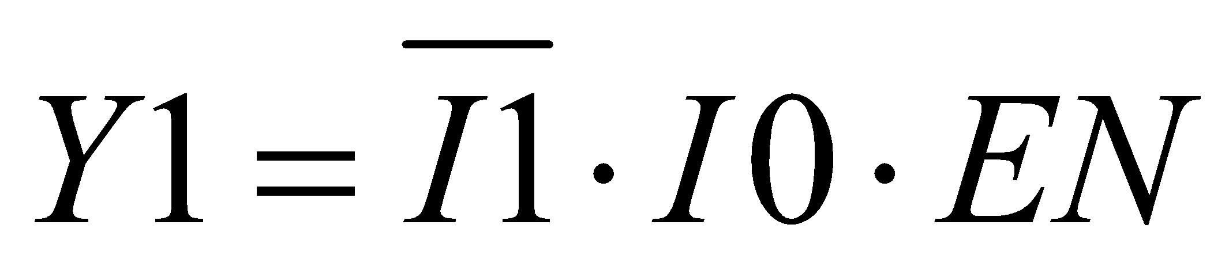


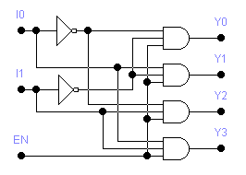
2 to 4 Decoder

Slide 50
3 TO 8 DECODER
No of Input Lines=3
No of Output Lines=8
Also 3x8 Decoder
3 line to 8 Line decoder
Binary to Octal Decoder
A | B | C | I7 | I6 | I5 | I4 | I3 | I2 | I1 | I0
0 | 0 | 0 | 0 | 0 | 0 | 0 | 0 | 0 | 0 | 1
0 | 0 | 1 | 0 | 0 | 0 | 0 | 0 | 0 | 1 | 0
0 | 1 | 0 | 0 | 0 | 0 | 0 | 0 | 1 | 0 | 0
0 | 1 | 1 | 0 | 0 | 0 | 0 | 1 | 0 | 0 | 0
1 | 0 | 0 | 0 | 0 | 0 | 1 | 0 | 0 | 0 | 0
1 | 0 | 1 | 0 | 0 | 1 | 0 | 0 | 0 | 0 | 0
1 | 1 | 0 | 0 | 1 | 0 | 0 | 0 | 0 | 0 | 0
1 | 1 | 1 | 1 | 0 | 0 | 0 | 0 | 0 | 0 | 0

Slide 51
3 TO 8 DECODER
A | B | C | I7 | I6 | I5 | I4 | I3 | I2 | I1 | I0
0 | 0 | 0 | 0 | 0 | 0 | 0 | 0 | 0 | 0 | 1
0 | 0 | 1 | 0 | 0 | 0 | 0 | 0 | 0 | 1 | 0
0 | 1 | 0 | 0 | 0 | 0 | 0 | 0 | 1 | 0 | 0
0 | 1 | 1 | 0 | 0 | 0 | 0 | 1 | 0 | 0 | 0
1 | 0 | 0 | 0 | 0 | 0 | 1 | 0 | 0 | 0 | 0
1 | 0 | 1 | 0 | 0 | 1 | 0 | 0 | 0 | 0 | 0
1 | 1 | 0 | 0 | 1 | 0 | 0 | 0 | 0 | 0 | 0
1 | 1 | 1 | 1 | 0 | 0 | 0 | 0 | 0 | 0 | 0
I0=A’B’C’
I1=A’B’C
I2=A’BC’
I3=A’BC
I4=AB’C’
I5=AB’C
I6=ABC’
I7=ABC

Slide 52
CODE CONVERTER
Binary to Gray Code Converter
Gray to Binary Code Converter
BCD to Ex-3 Code Converter

Slide 53
FOUR BIT BINARY TO GRAY CODE CONVERTER –DESIGN (1)…
TRUTH TABLE:
Decimal | INPUT ( BINARY) |  |  |  |  | OUTPUTS (GRAY CODE)
 | B3 | B2 | B1 | B0 |  | G3 | G2 | G1 | G0
0 | 0 | 0 | 0 | 0 |  | 0 | 0 | 0 | 0
1 | 0 | 0 | 0 | 1 |  | 0 | 0 | 0 | 1
2 | 0 | 0 | 1 | 0 |  | 0 | 0 | 1 | 1
3 | 0 | 0 | 1 | 1 |  | 0 | 0 | 1 | 0
4 | 0 | 1 | 0 | 0 |  | 0 | 1 | 1 | 0
5 | 0 | 1 | 0 | 1 |  | 0 | 1 | 1 | 1
6 | 0 | 1 | 1 | 0 |  | 0 | 1 | 0 | 1
7 | 0 | 1 | 1 | 1 |  | 0 | 1 | 0 | 0
8 | 1 | 0 | 0 | 0 |  | 1 | 1 | 0 | 0
9 | 1 | 0 | 0 | 1 |  | 1 | 1 | 0 | 1
10 | 1 | 0 | 1 | 0 |  | 1 | 1 | 1 | 1
11 | 1 | 0 | 1 | 1 |  | 1 | 1 | 1 | 0
12 | 1 | 1 | 0 | 0 |  | 1 | 0 | 1 | 0
13 | 1 | 1 | 0 | 1 |  | 1 | 0 | 1 | 1
14 | 1 | 1 | 1 | 0 |  | 1 | 0 | 0 | 1
15 | 1 | 1 | 1 | 1 |  | 1 | 0 | 0 | 0

Slide 54
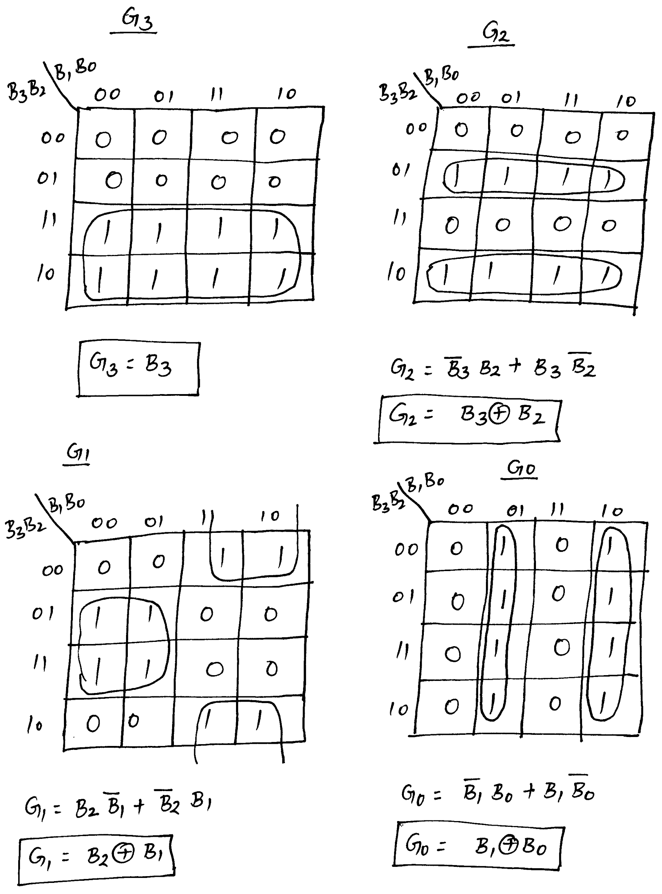
FOUR BIT BINARY TO GRAY CODE CONVERTER –DESIGN (2)…
Simplification using K-maps:

Slide 55
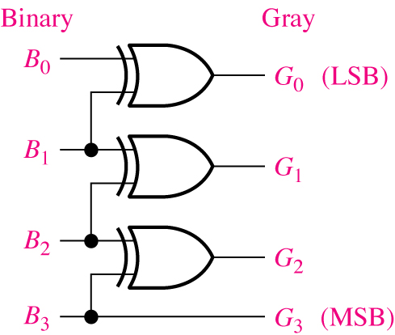
FOUR BIT BINARY TO GRAY CODE CONVERTER –DESIGN (3)
Logic Diagram:

Slide 56
FOUR BIT GRAY CODE TO BINARY CONVERTER –DESIGN (1)…
Truth Table:
Decimal | INPUT ( GRAY CODE) |  |  |  |  | OUTPUTS (BINARY )
 | G3 | G2 | G1 | G0 |  | B3 | B2 | B1 | B0
0 | 0 | 0 | 0 | 0 |  | 0 | 0 | 0 | 0
1 | 0 | 0 | 0 | 1 |  | 0 | 0 | 0 | 1
2 | 0 | 0 | 1 | 1 |  | 0 | 0 | 1 | 0
3 | 0 | 0 | 1 | 0 |  | 0 | 0 | 1 | 1
4 | 0 | 1 | 1 | 0 |  | 0 | 1 | 0 | 0
5 | 0 | 1 | 1 | 1 |  | 0 | 1 | 0 | 1
6 | 0 | 1 | 0 | 1 |  | 0 | 1 | 1 | 0
7 | 0 | 1 | 0 | 0 |  | 0 | 1 | 1 | 1
8 | 1 | 1 | 0 | 0 |  | 1 | 0 | 0 | 0
9 | 1 | 1 | 0 | 1 |  | 1 | 0 | 0 | 1
10 | 1 | 1 | 1 | 1 |  | 1 | 0 | 1 | 0
11 | 1 | 1 | 1 | 0 |  | 1 | 0 | 1 | 1
12 | 1 | 0 | 1 | 0 |  | 1 | 1 | 0 | 0
13 | 1 | 0 | 1 | 1 |  | 1 | 1 | 0 | 1
14 | 1 | 0 | 0 | 1 |  | 1 | 1 | 1 | 0
15 | 1 | 0 | 0 | 0 |  | 1 | 1 | 1 | 1

Slide 57
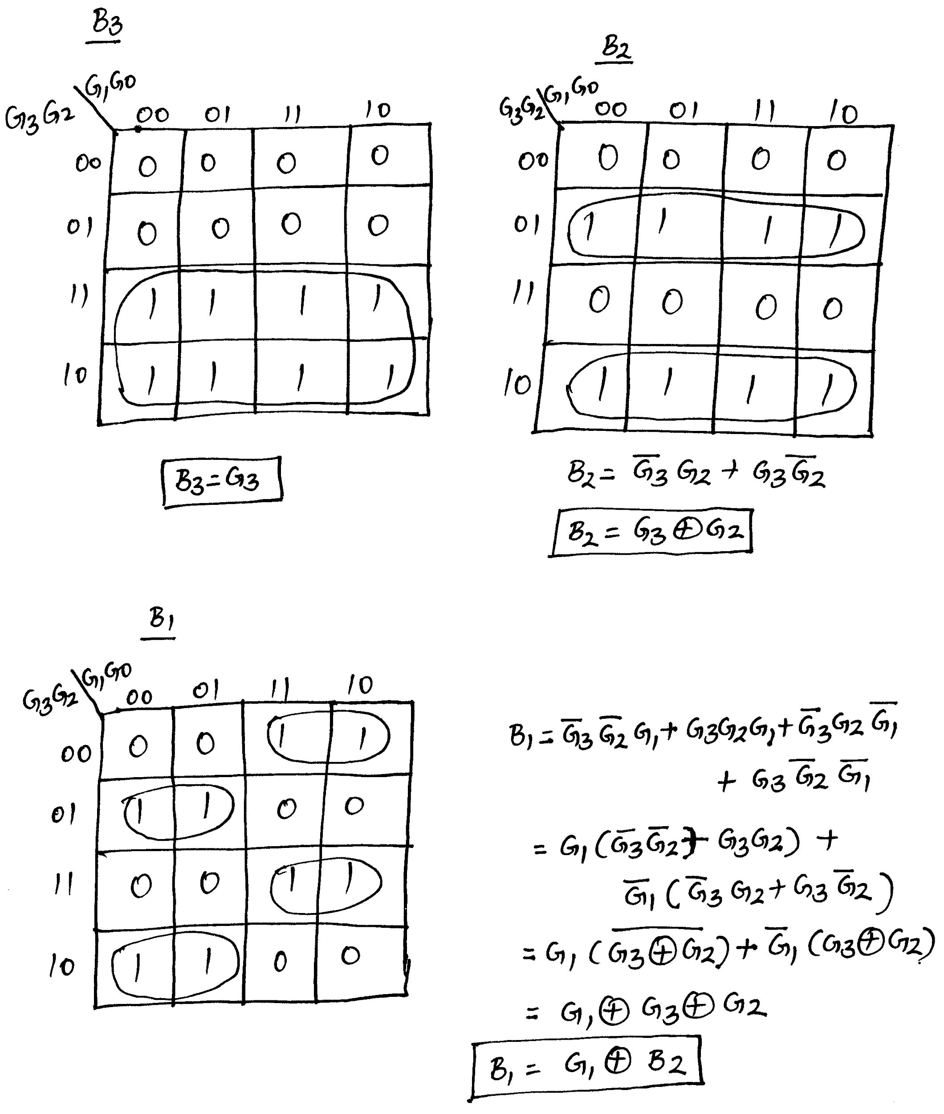
FOUR BIT GRAY CODE TO BINARY CONVERTER –DESIGN (2)…
Simplification using K-Maps:

Slide 58
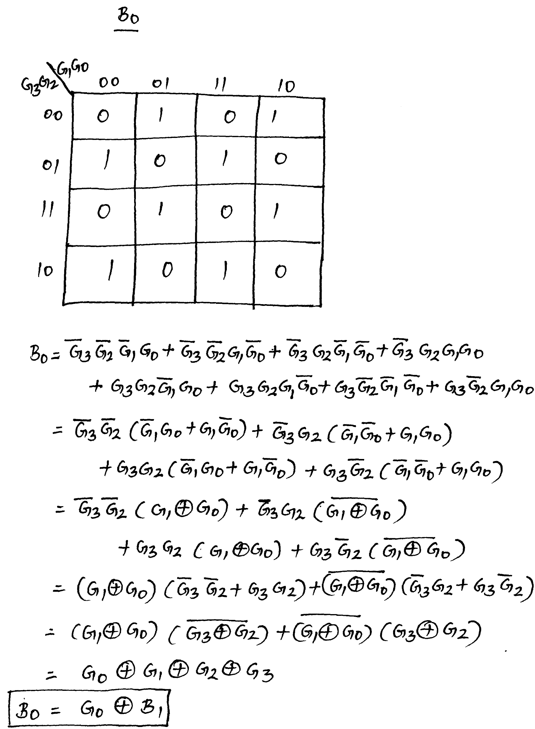
FOUR BIT GRAY CODE TO BINARY CONVERTER –DESIGN (3)…
Simplification using K-Maps:

Slide 59
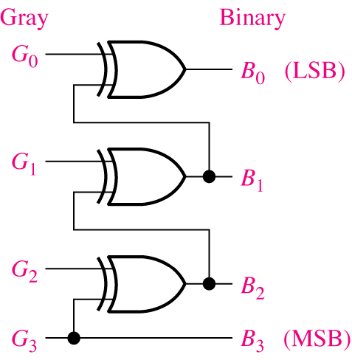
FOUR BIT GRAY CODE TO BINARY CONVERTER –DESIGN (4)
Logic Diagram:

Slide 60
BCD to XS 3 code converter- Design (1)...
TRUTH TABLE FOR BCD TO XS3 CODE CONVERTER:
Input ( Std BCD code) |  |  |  |  | Output ( XS3 Code)
A | B | C | D |  | w | x | y | z
0 | 0 | 0 | 0 |  | 0 | 0 | 1 | 1
0 | 0 | 0 | 1 |  | 0 | 1 | 0 | 0
0 | 0 | 1 | 0 |  | 0 | 1 | 0 | 1
0 | 0 | 1 | 1 |  | 0 | 1 | 1 | 0
0 | 1 | 0 | 0 |  | 0 | 1 | 1 | 1
0 | 1 | 0 | 1 |  | 1 | 0 | 0 | 0
0 | 1 | 1 | 0 |  | 1 | 0 | 0 | 1
0 | 1 | 1 | 1 |  | 1 | 0 | 1 | 0
1 | 0 | 0 | 0 |  | 1 | 0 | 1 | 1
1 | 0 | 0 | 1 |  | 1 | 1 | 0 | 0
1 | 0 | 1 | 0 |  | X | X | X | X
1 | 0 | 1 | 1 |  | X | X | X | X
1 | 1 | 0 | 1 |  | X | X | X | X
1 | 1 | 1 | 0 |  | X | X | X | X
1 | 1 | 1 | 1 |  | X | X | X | X

Slide 61
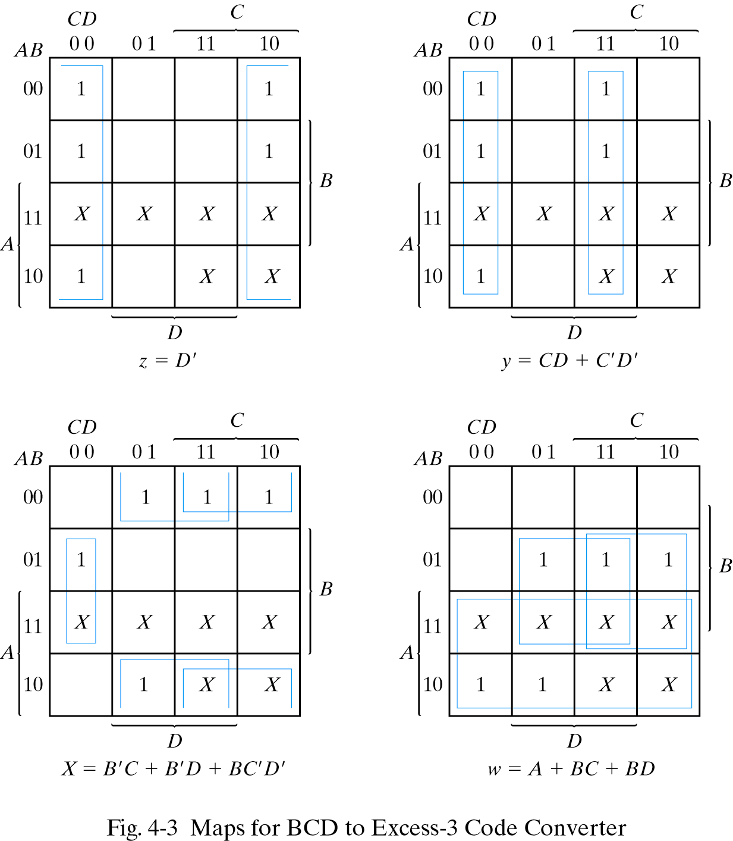
BCD to XS 3 code converter- Design (2)...
K-maps for simplification and simplified Boolean expressions

Slide 62
BCD to XS 3 code converter- Design (3)...
After the manipulation of the Boolean expressions for using common gates for two or more outputs, logic expressions can be given by
z=D’
y=CD+C’D’ = CD + (C+D)’
x= B’C + B’D + BC’D’ = B’(C+D) + BC’D’
w= A + BC + BD = A + B (C+D)

Slide 63
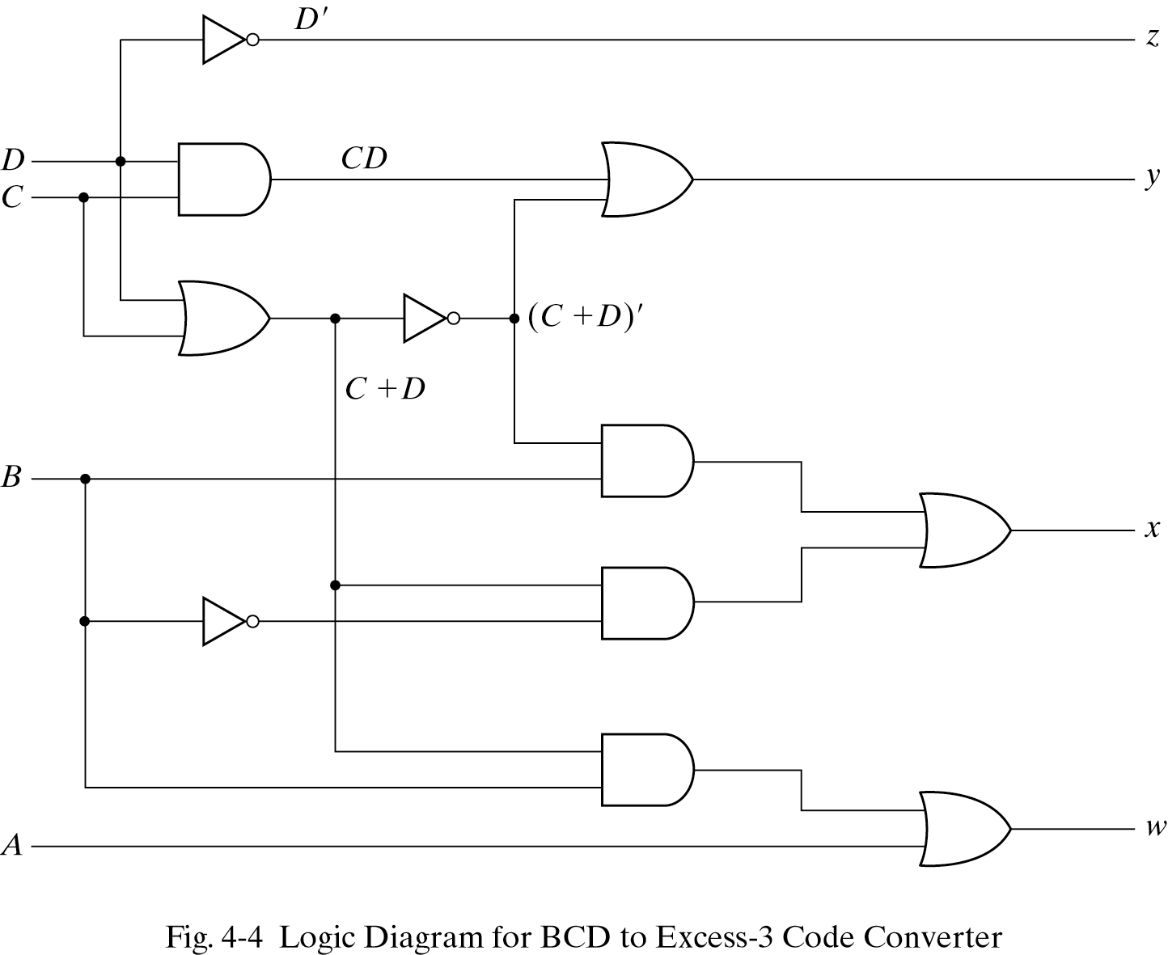
BCD to XS 3 code converter- Design (4)

